Slide 1
NeuLion中国新员工入职培训
QoS Team
June 25 – 27， 2014

Slide 2

A metaphor for QoS
NeuLion Service

Slide 3
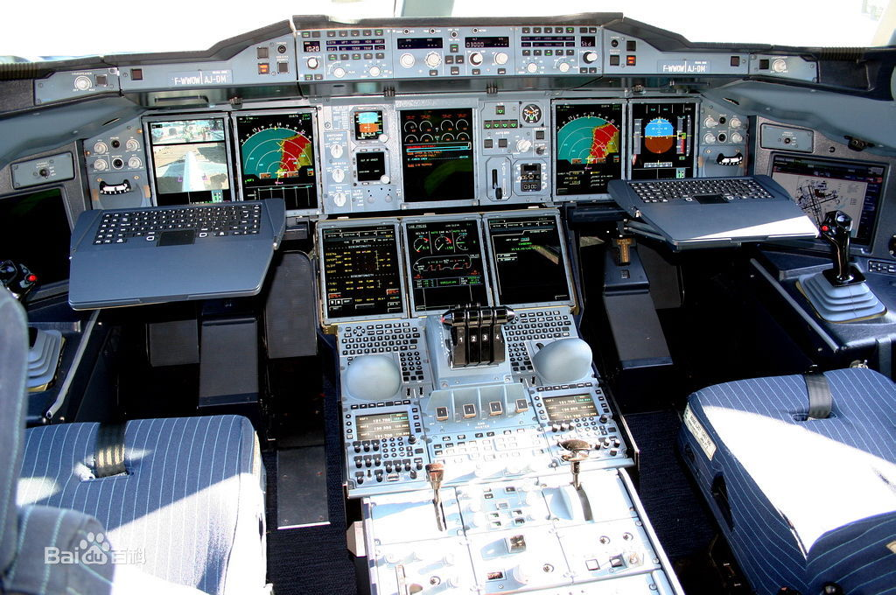
A metaphor for QoS
QoS

Slide 4
QoS
A product which provides data about quality of service (QoS) for our operators, executives and client.
Notes:
5分钟

Slide 5
What metrics do we provide
Online visitor / online view
Unique Visitor / video playbacks
Watch duration
Bitrate (dropframe, buffer ratio, startup time, bandwidth)
CDN throughput

Slide 6
We also know the details
Any Site
nba, nfl, nhl, cntv
Any Time
realtime, or any time in the past
Any Location
country, city, IP address
Any Device
mac, ipad, iphone, sumsung…
Any Content
each game, each highlight

Slide 7
How people use QoS
Monitoring
End user track
Summary report
Raw CSV files
Data API for Web/IMS

Slide 8
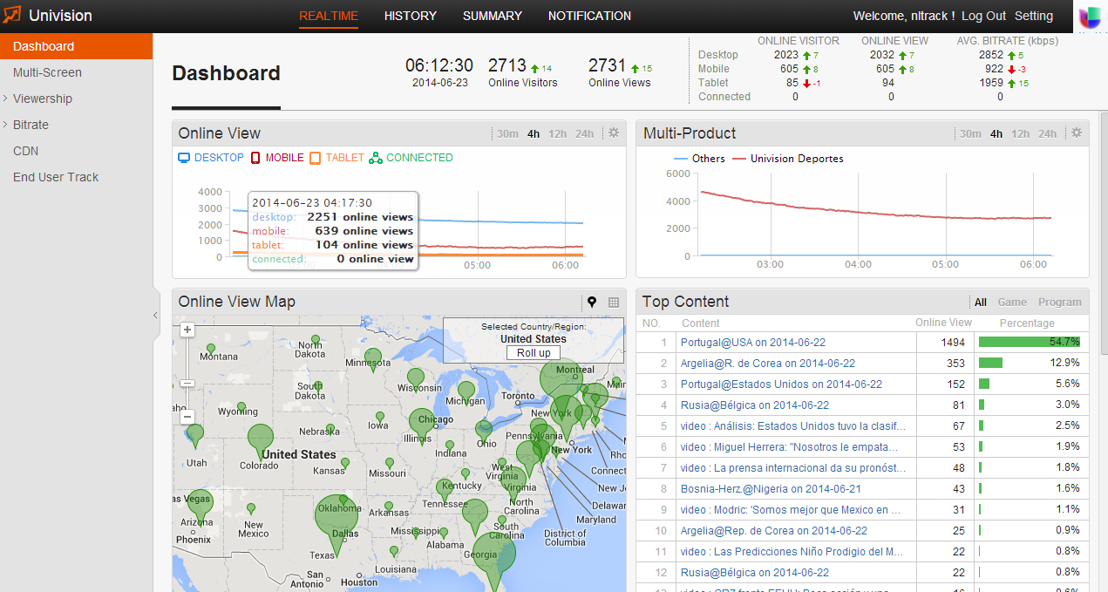
How people use QoS: Monitoring

Slide 9
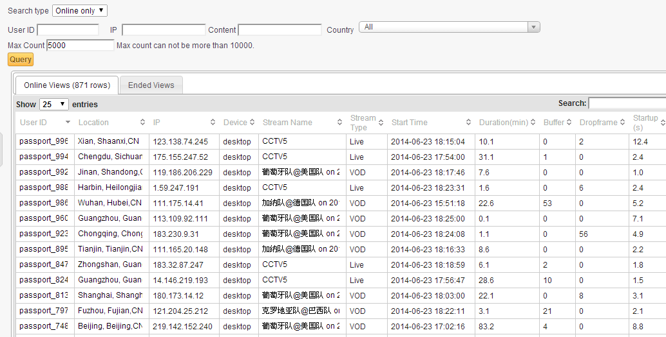
How people use QoS: End User Track

Slide 10
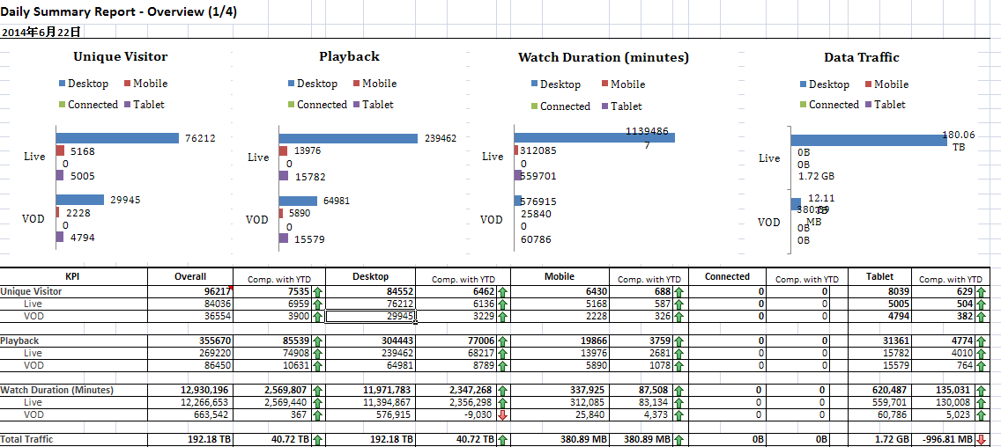
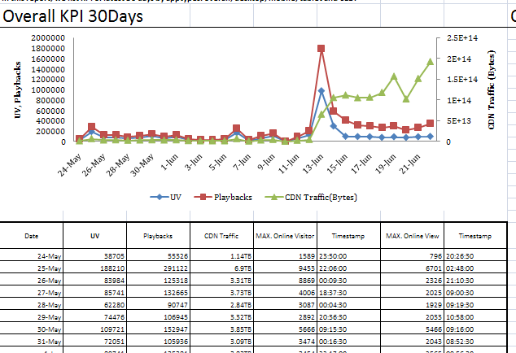
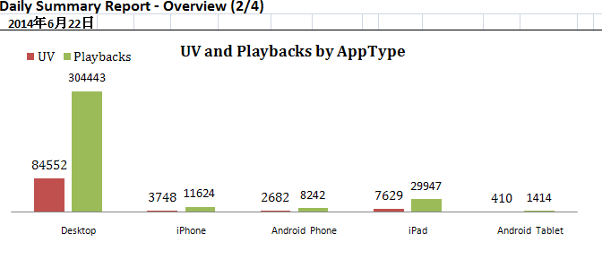
How people use QoS: Summary report

Slide 11
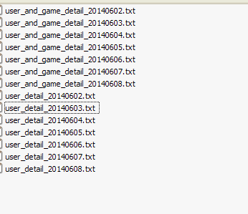
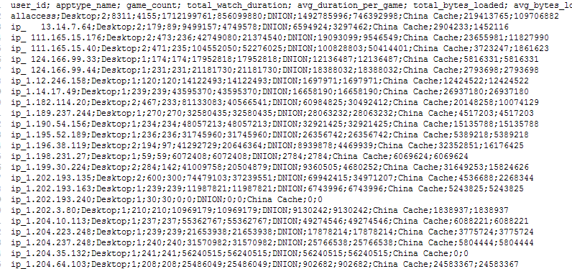
How people use QoS: CSV files

Slide 12
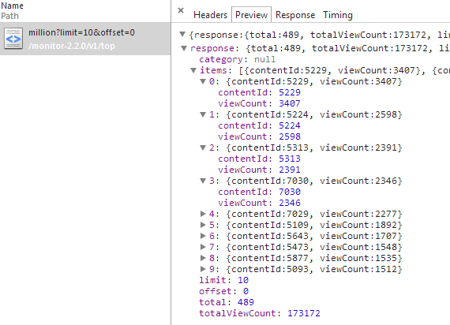
How people use QoS: Data API

Slide 13
How do we collect data
Receiver
Stats server
Monitor

Slide 14
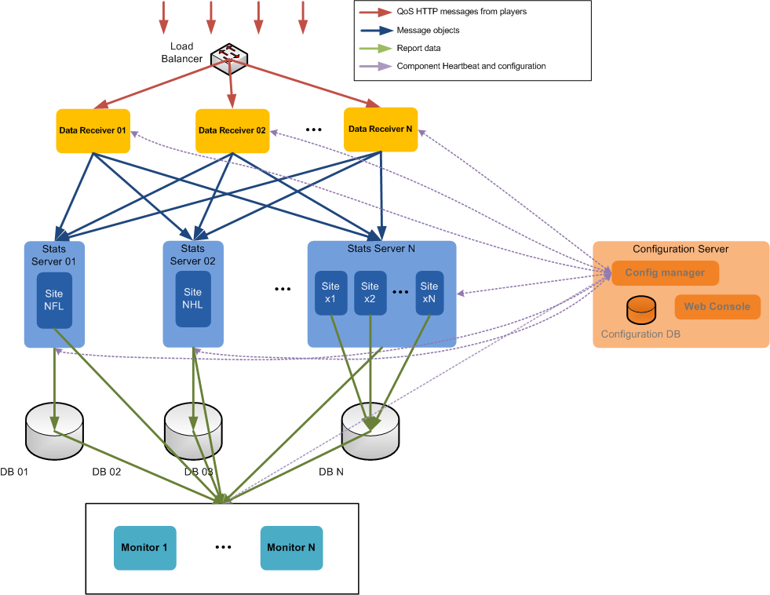
Architecture

Slide 15
How many roads has QoS walked
2010.8 v1
Java+MySQL+Mondrian
Flex-based UI
2012.9 v2
Multi-screen
HTML-based UI
2014.6 v2.2
Multi-site / Multi-product
In-memory calculation engine
Configuration-center

Slide 16
Crew
Daisy,
Don,
Grace^{new~},
JinJie,
Richard,
Yihua^{new~}

Slide 17
Q&A

